Slide 1

Closed-Loop Carbon Cycle: Generating Electricity From Graphite Combustion and Regeneration for Sustainable Energy Production
Affordable and clear energy

Slide 2
Table of contents
SDG
Solution
Prototype & Analysis
The problem
Selected solution and prototype
Analysis and results
Disadvantages of the present solutions
Future work
3D modeling
Mechanism

Slide 3
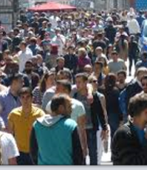
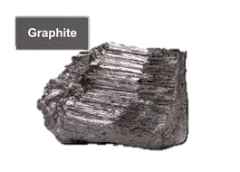
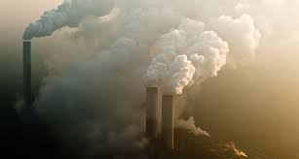
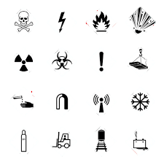
SDG
Solution
Prototype & Analysis
Graphite consuming for combustion
Emissions
Safety hazards

Slide 4
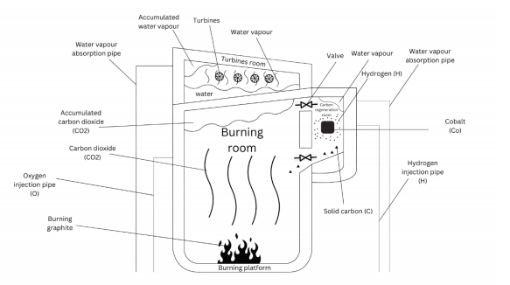
SDG
Solution
Prototype & Analysis
Burning room
Turbines room
Carbon Regeneration Chamber

Slide 5
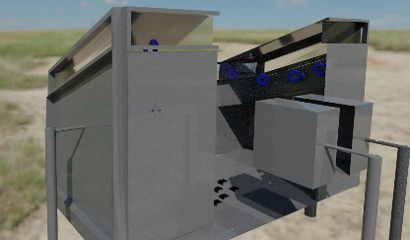
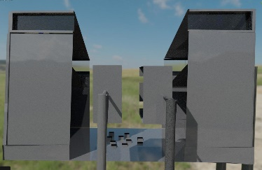
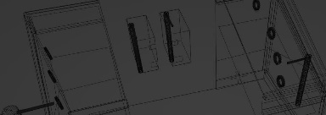
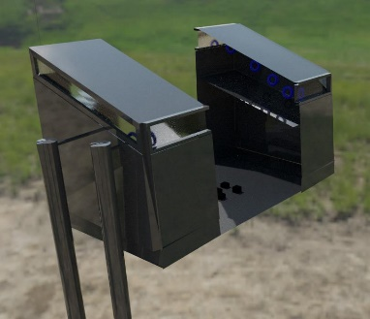
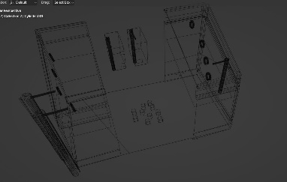
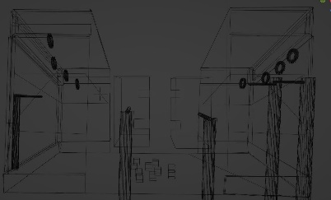
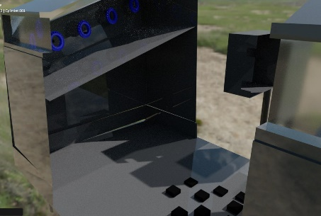
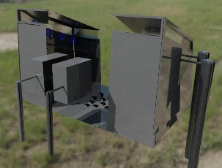
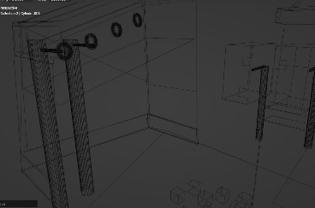
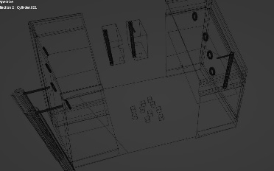
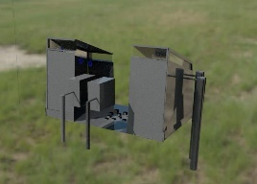
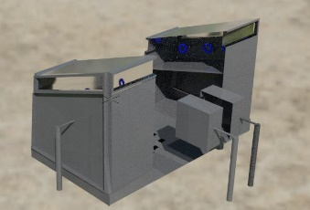
SDG
Solution
Prototype & Analysis
Next

Slide 6

SDG
Solution
Prototype & Analysis
Go back

Slide 7
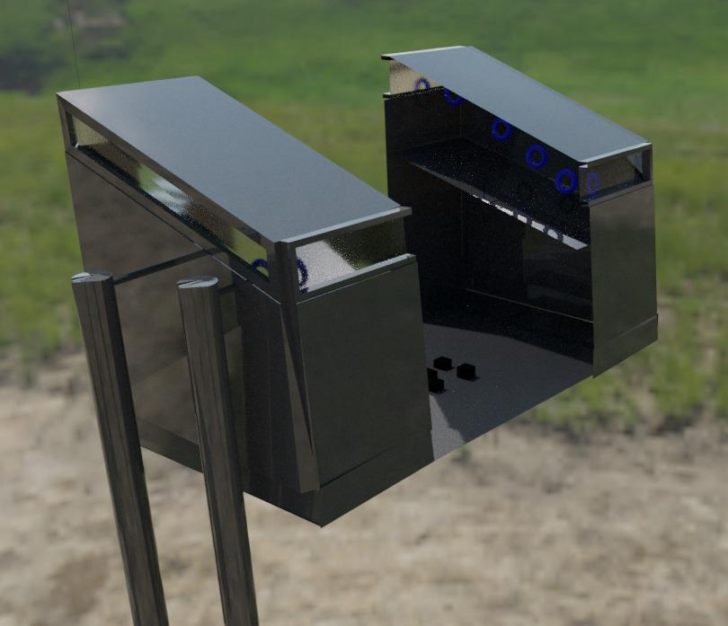

SDG
Solution
Prototype & Analysis
Go back

Slide 8
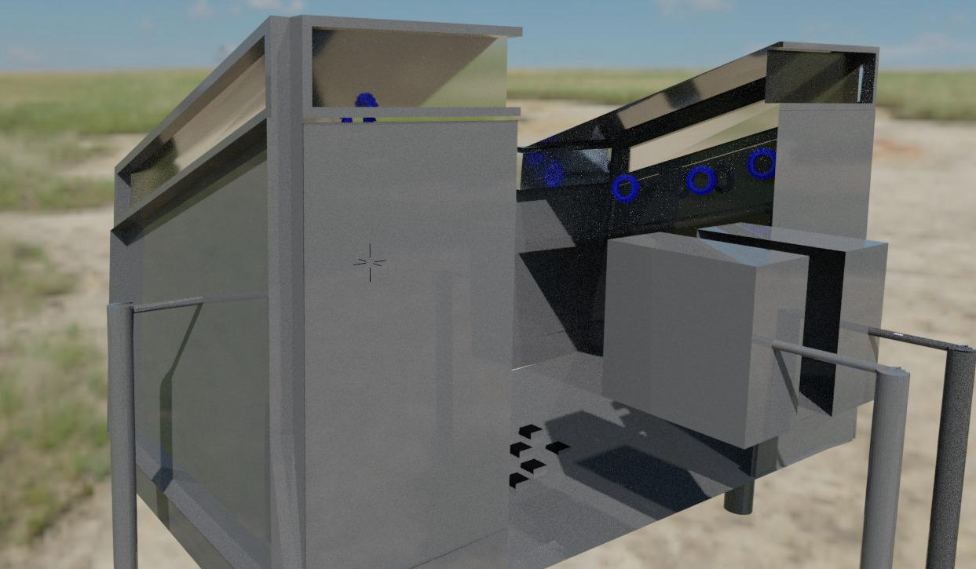

SDG
Solution
Prototype & Analysis
Go back

Slide 9
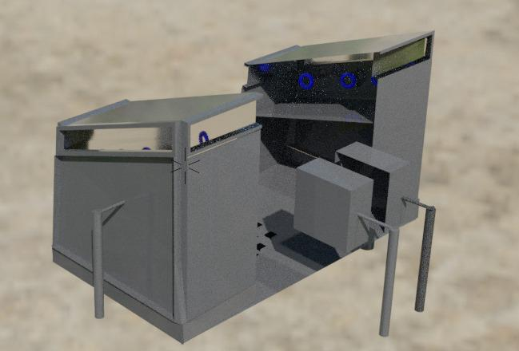

SDG
Solution
Prototype & Analysis
Go back

Slide 10

SDG
Solution
Prototype & Analysis
Go back

Slide 11

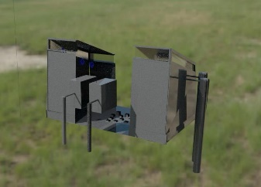
SDG
Solution
Prototype & Analysis
Go back

Slide 12


SDG
Solution
Prototype & Analysis
Go back

Slide 13


SDG
Solution
Prototype & Analysis
Go back

Slide 14
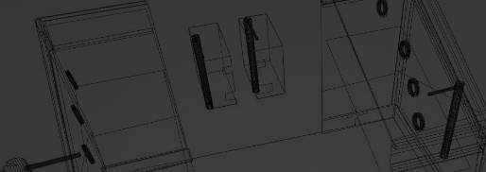
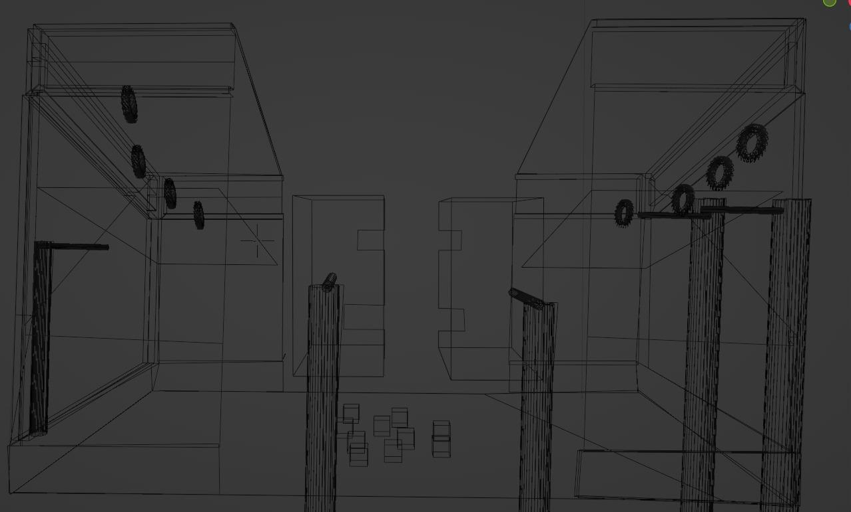
SDG
Solution
Prototype & Analysis
Go back

Slide 15
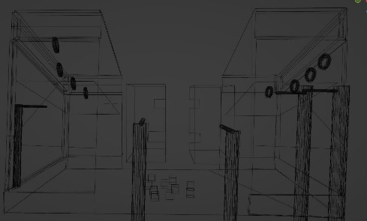
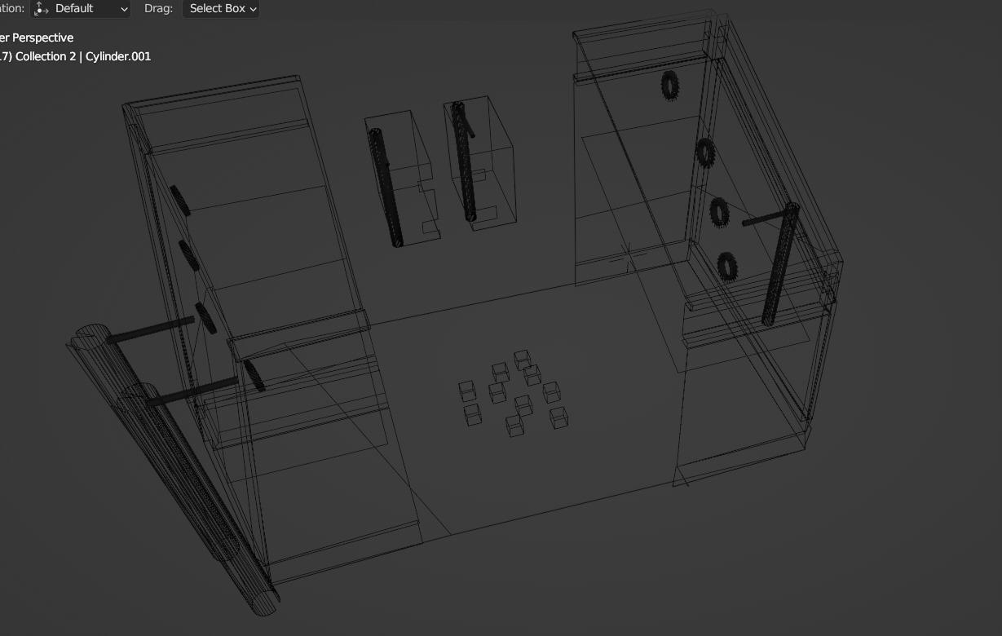
SDG
Solution
Prototype & Analysis
Go back

Slide 16
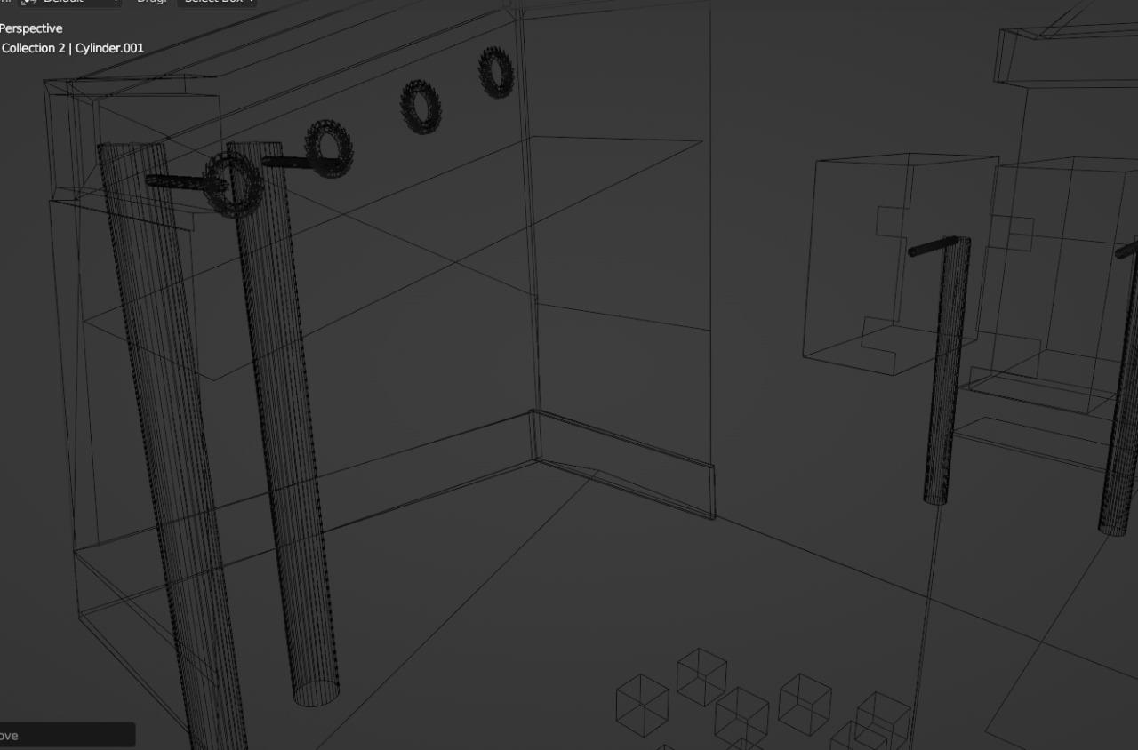
SDG
Solution
Prototype & Analysis
Go back

Slide 17
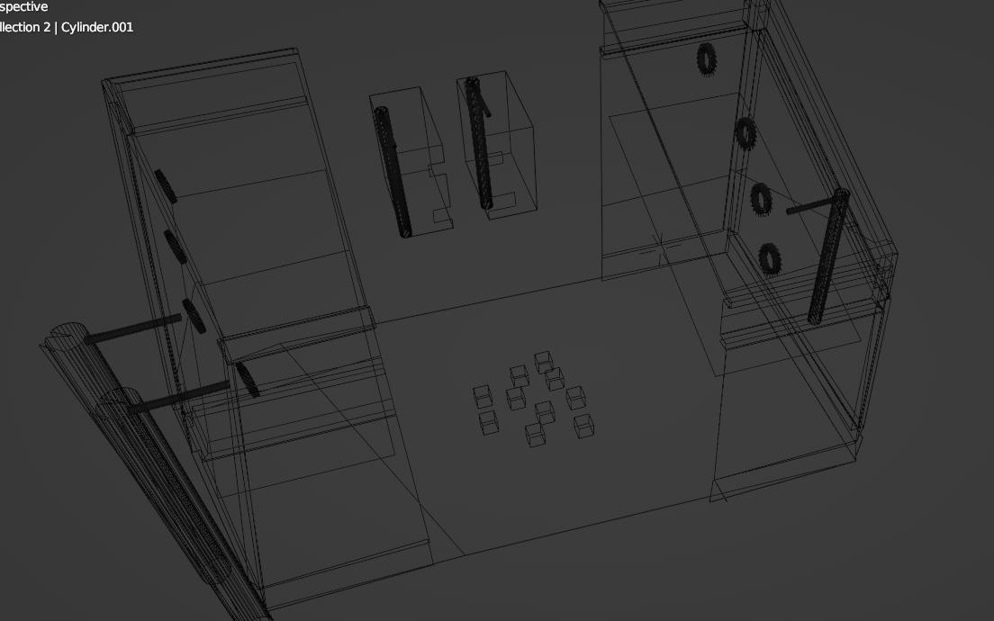
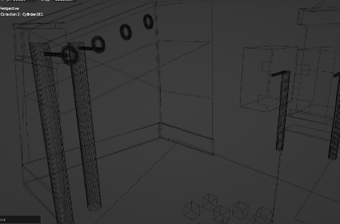
SDG
Solution
Prototype & Analysis
Go back

Slide 18
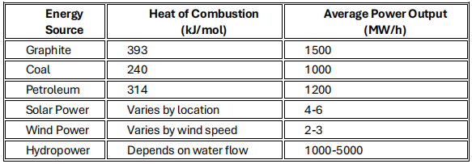
SDG
Solution
Prototype & Analysis
Selection of Graphite

Slide 19
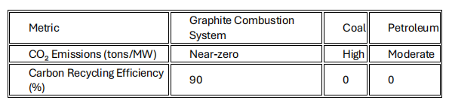
SDG
Solution
Prototype & Analysis
Comparison of CO₂ Emissions and Recycling Efficiency Across Energy Sources

Slide 20
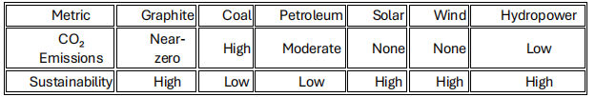
SDG
Solution
Prototype & Analysis
Environmental Impact Comparison Across Energy Sources

Slide 21
Thank you

